Slide 1

Hospital Inventory Data Base
By Jaime Aparicio, Javier Gallego and Andrea Martínez

Slide 2
Index
Introduction
1
Problem to solve
Aims of the project
Architecture
2
Structure
E-R Diagram
UML Use Case Diagram
Implementation
3

Slide 3
Introduction: problem to solve
Lots of medical supplies
Control of the inventory is crucial
Help hospitals

Slide 4
Introduction: aims of the project
Easy to use
Simple
Functional
Useful

Slide 5
Architecture: structure
Administrator
Doctor
Nurse
Order
Distributor
Treatment
Materials

Slide 6
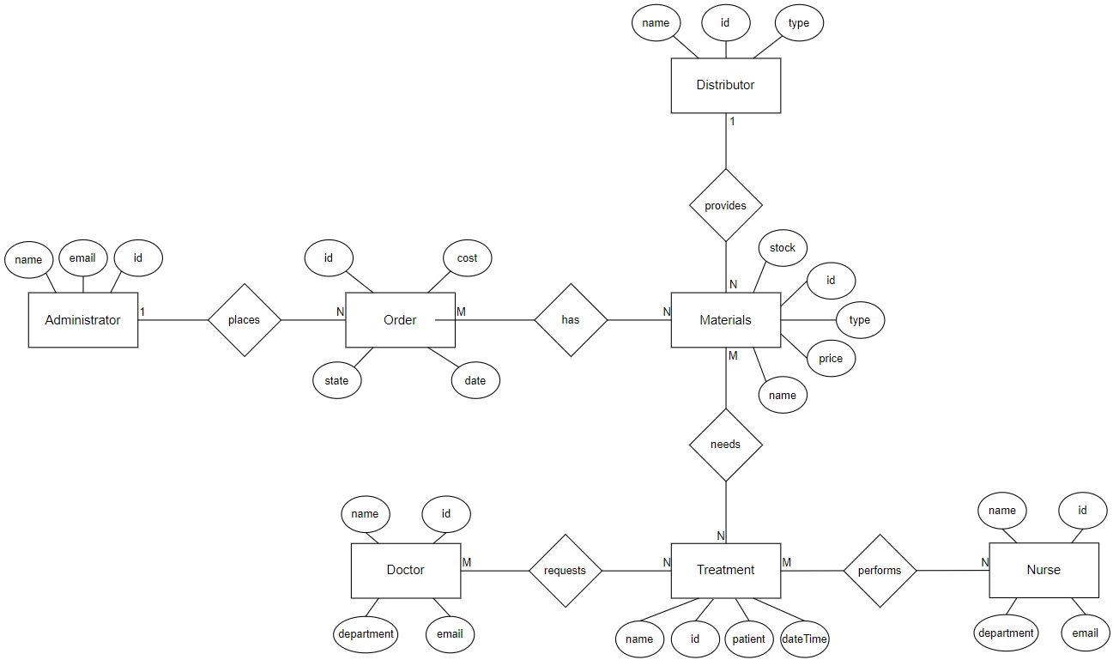
Architecture: E-R Diagram

Slide 7
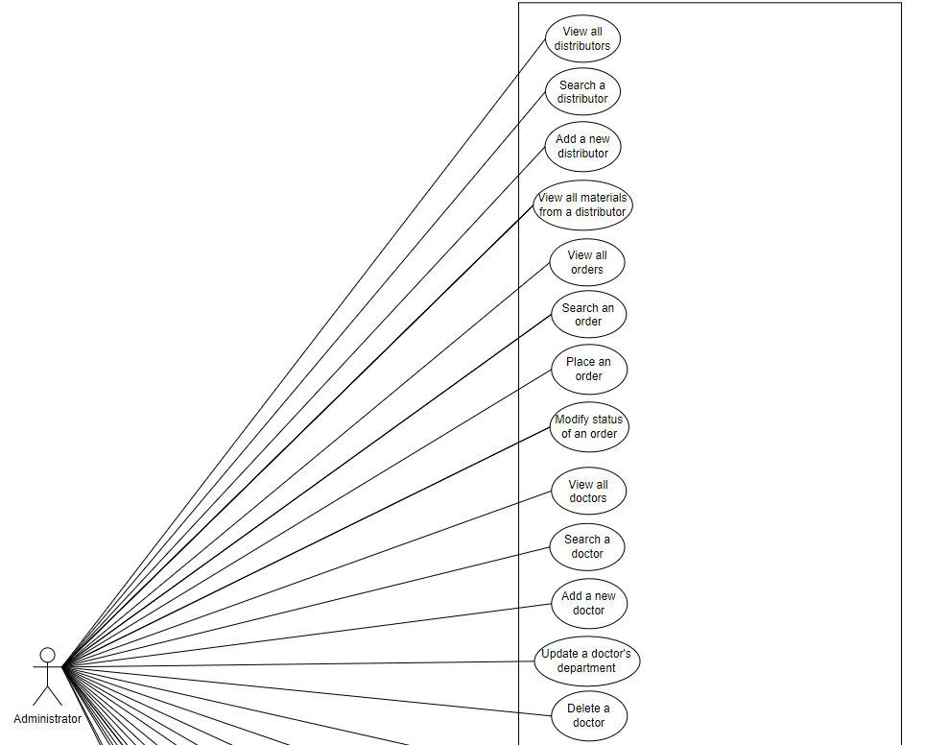
Architecture: UML Use Case Diagram

Slide 8
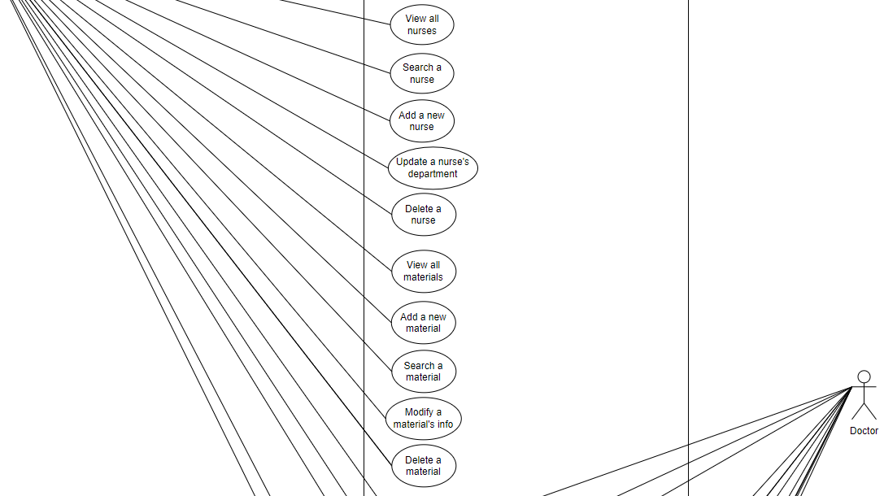
Architecture: UML Use Case Diagram

Slide 9
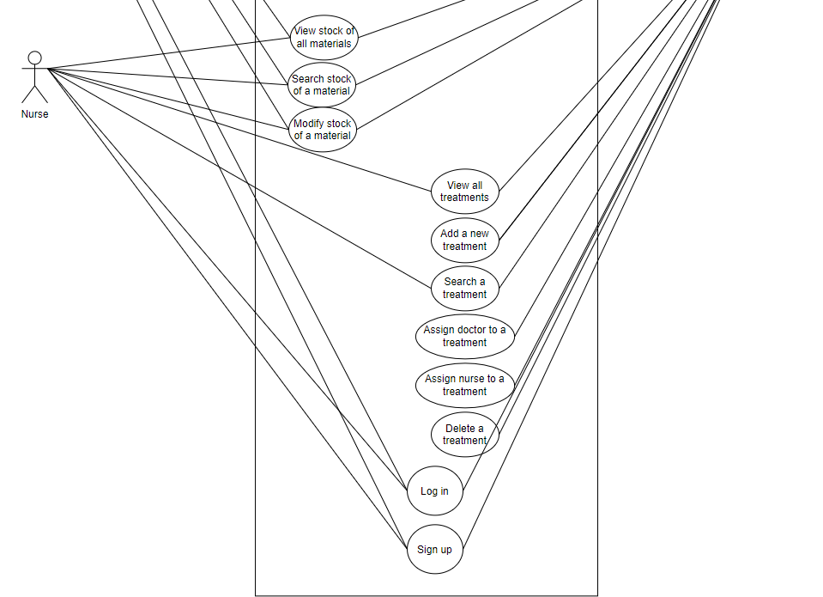
Architecture: UML Use Case Diagram

Slide 10
Implementation
Choose an option:
Log in administrator
Log in doctor
Log in nurse
Sign up
Exit

Slide 11
Implementation
Choose an option:
Log in administrator
Log in doctor
Log in nurse
Sign up
Exit
4

Slide 12
Implementation
What do you want to sign up as?
Administrator
Doctor
Nurse

Slide 13
Implementation
What do you want to sign up as?
Administrator
Doctor
Nurse
1

Slide 14
Implementation
Sign up as administrator
Name:

Slide 15
Implementation
Sign up as administrator
Name:
example

Slide 16
Implementation
Sign up as administrator
Name:
example
Email:

Slide 17
Implementation
Sign up as administrator
Name:
example
Email:
example@gmail.com

Slide 18
Implementation
Sign up as administrator
Name:
example
Email:
example@gmail.com
Password:

Slide 19
Implementation
Sign up as administrator
Name:
example
Email:
example@gmail.com
Password:
examplePassword

Slide 20
Implementation
Sign up as administrator
Name:
example
Email:
example@gmail.com
Password:
examplePassword
Sign up succesful!

Slide 21
Implementation
Choose an option:
Log in administrator
Log in doctor
Log in nurse
Sign up
Exit

Slide 22
Implementation
Choose an option:
Log in administrator
Log in doctor
Log in nurse
Sign up
Exit
1

Slide 23
Implementation
Email:

Slide 24
Implementation
Email:
example@gmail.com

Slide 25
Implementation
Email:
example@gmail.com
Password:

Slide 26
Implementation
Email:
example@gmail.com
Password:
examplePassword

Slide 27
Implementation
Email:
example@gmail.com
Password:
examplePassword
Log in succesful!

Slide 28
Implementation
Administrator Menu
Choose an option:
Work with materials
Work with distributors
Work with orders
Work with doctors
Work with nurses
Exit

Slide 29
Implementation
Administrator Menu
Choose an option:
Work with materials
Work with distributors
Work with orders
Work with doctors
Work with nurses
Exit
1

Slide 30
Implementation
Administrator Menu - Materials
Choose an option:
View all materials
Search a material
Add a new material
Modify an existing material
Delete a material
View full stock
Search stock of a material
Modify stock of a material
Back

Slide 31
Implementation
Administrator Menu - Materials
Choose an option:
View all materials
Search a material
Add a new material
Modify an existing material
Delete a material
View full stock
Search stock of a material
Modify stock of a material
Back
1

Slide 32
Implementation
Administrator Menu - Materials
Materials
Id = 0 Name = ibuprofen Type = medicament Stock = 254 Price = 10,00 Distributor = Bayer
Id = 1 Name = scalpel Type = instrument Stock = 130 Price = 2,99 Distributor = J&J
Id = 2 Name = TAC Type = machine Stock = 1 Price = 15000 Distributor = Mach

Slide 33
Implementation
Administrator Menu - Materials
Choose an option:
View all materials
Search a material
Add a new material
Modify an existing material
Delete a material
View full stock
Search stock of a material
Modify stock of a material
Back

Slide 34
Implementation
Administrator Menu - Materials
Choose an option:
View all materials
Search a material
Add a new material
Modify an existing material
Delete a material
View full stock
Search stock of a material
Modify stock of a material
Back
3

Slide 35
Implementation
Administrator Menu – Materials
Type name:

Slide 36
Implementation
Administrator Menu – Materials
Type name:
COVID Vaccine

Slide 37
Implementation
Administrator Menu – Materials
Type name:
COVID Vaccine
Type type of material:

Slide 38
Implementation
Administrator Menu – Materials
Type name:
COVID Vaccine
Type type of material:
Vaccine

Slide 39
Implementation
Administrator Menu – Materials
Type name:
COVID Vaccine
Type type of material:
Vaccine
Type the initial stock:

Slide 40
Implementation
Administrator Menu – Materials
Type name:
COVID Vaccine
Type type of material:
Vaccine
Type the initial stock:
220

Slide 41
Implementation
Administrator Menu – Materials
Type name:
COVID Vaccine
Type type of material:
Vaccine
Type the initial stock:
220
Type the price:

Slide 42
Implementation
Administrator Menu – Materials
Type name:
COVID Vaccine
Type type of material:
Vaccine
Type the initial stock:
220
Type the price:
25,00

Slide 43
Implementation
Administrator Menu – Materials
0 -> Bayer
1 -> J&J
2 -> Mach
3 -> Astrazeneca

Slide 44
Implementation
Administrator Menu – Materials
0 -> Bayer
1 -> J&J
2 -> Mach
3 -> Astrazeneca
Type the id of the distributor:

Slide 45
Implementation
Administrator Menu – Materials
0 -> Bayer
1 -> J&J
2 -> Mach
3 -> Astrazeneca
Type the id of the distributor:
3

Slide 46
Implementation
Administrator Menu – Materials
0 -> Bayer
1 -> J&J
2 -> Mach
3 -> Astrazeneca
Type the id of the distributor:
3
Material added.

Slide 47
Implementation
Administrator Menu - Materials
Choose an option:
View all materials
Search a material
Add a new material
Modify an existing material
Delete a material
View full stock
Search stock of a material
Modify stock of a material
Back

Slide 48
Implementation
Administrator Menu - Materials
Choose an option:
View all materials
Search a material
Add a new material
Modify an existing material
Delete a material
View full stock
Search stock of a material
Modify stock of a material
Back
9

Slide 49
Implementation
Administrator Menu
Choose an option:
Work with materials
Work with distributors
Work with orders
Work with doctors
Work with nurses
Exit

Slide 50
Implementation
Administrator Menu
Choose an option:
Work with materials
Work with distributors
Work with orders
Work with doctors
Work with nurses
Exit
6

Slide 51
Implementation

Slide 52

ANY QUESTIONS?

